Slide 1

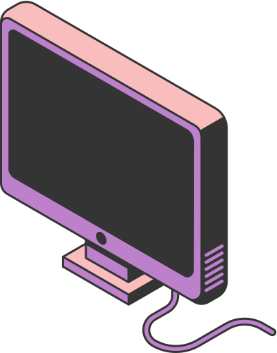
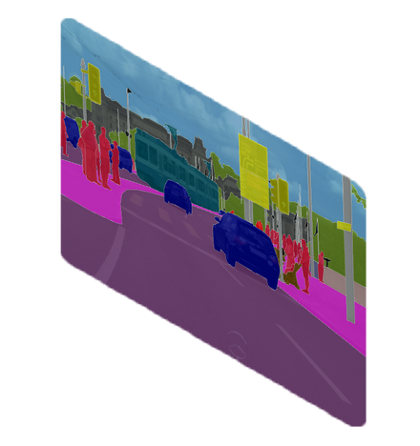
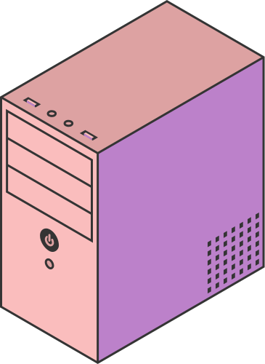
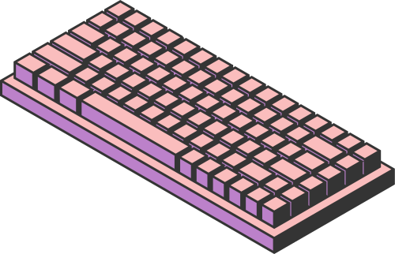
IMAGE
SEGMENTATION
Computer Vision Project
Page 01

Slide 2
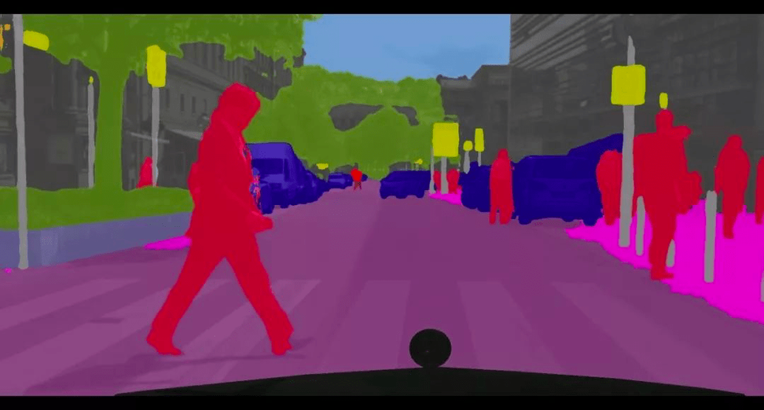
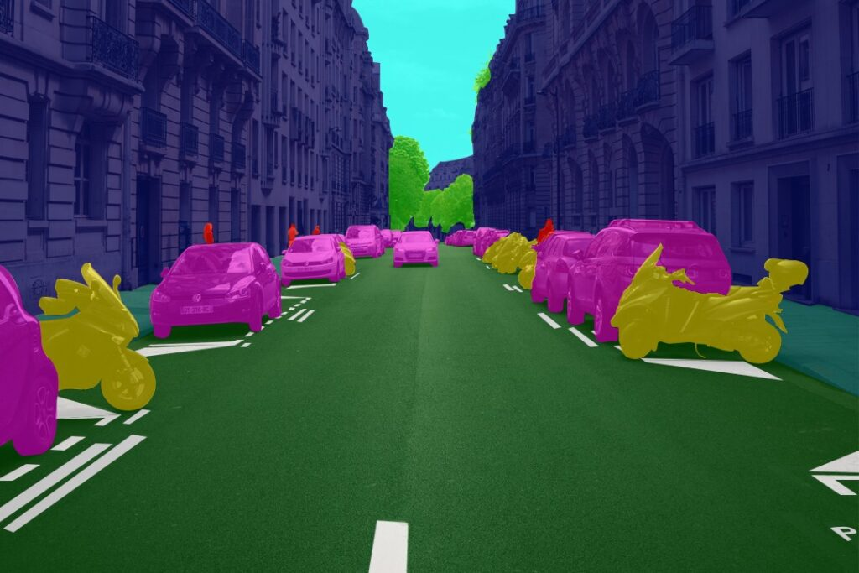
INTRODUCTION
Image segmentation is a critical task in computer vision that involves dividing an image into distinct regions, where each region corresponds to a different object or part of the image. Unlike traditional image classification, where the goal is to assign a single label to an entire image, segmentation allows us to label each pixel individually, enabling more detailed analysis and precise understanding of image content.

Slide 3
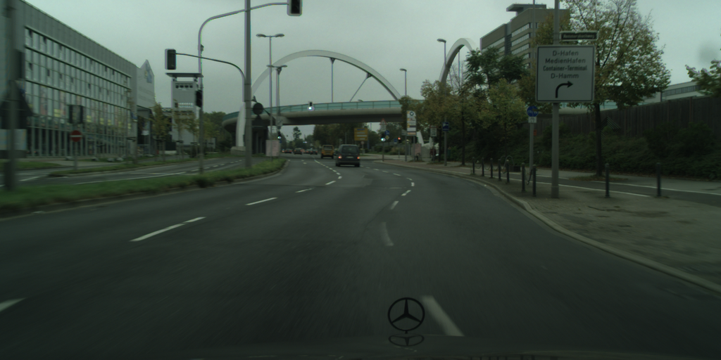
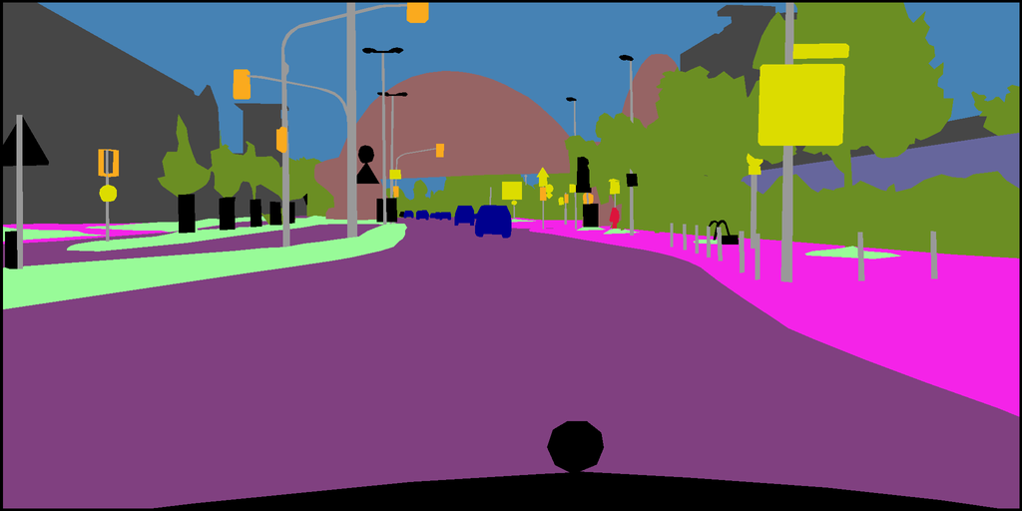
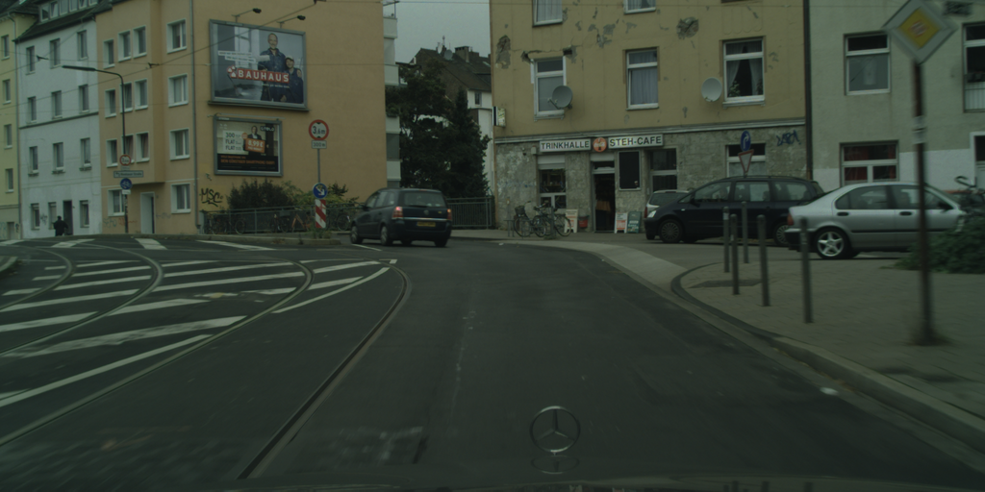
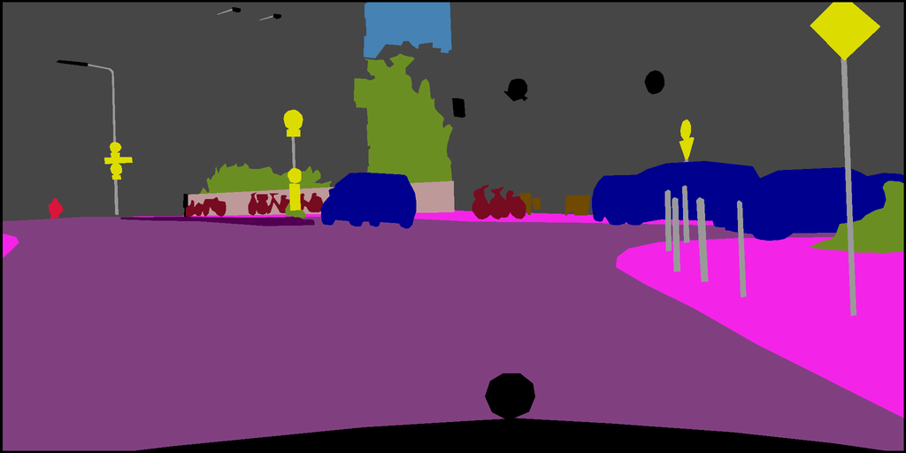
DATASET
Cityscapes Dataset
2975 Train Images
500 Validation Images
Input Image Shape
(128, 256, 3)
Output Image Shape
(128, 256, 1)

Slide 4
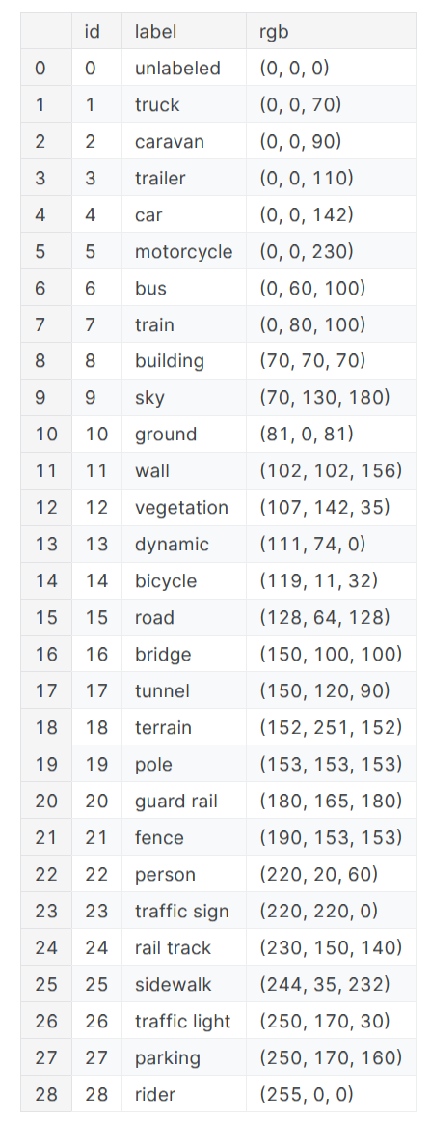
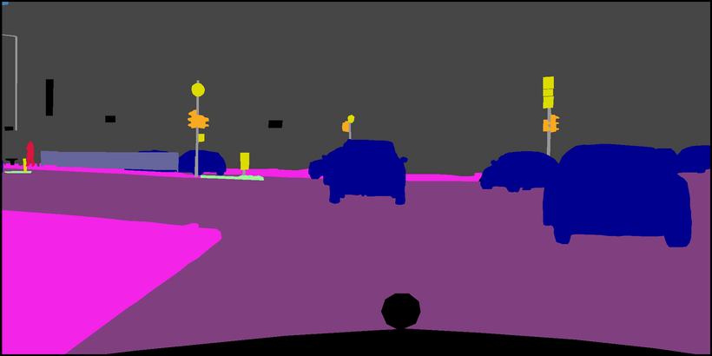
ID-Color Mapping
The output shape is then converted to an RGB image, assigning specific colors to each predicted ID. This approach ensures that the model generates only the allowed colors, making the segmentation process more consistent.
...

Slide 5
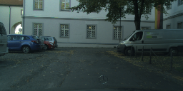

SEGNET MODEL
Input & Output
MODEL
(128, 256, 3)
(128, 256, ID)

Slide 6
SEGNET MODEL
What is SegNet
SegNet is an encoder-decoder architecture designed for pixel-wise image segmentation. It takes an input image and outputs a segmentation map where each pixel is classified into one of the given categories (in this case, 29 classes).
Why SegNet
SegNet is widely used because it efficiently learns feature representations and provides high-resolution segmentation outputs while being computationally efficient.

Slide 7
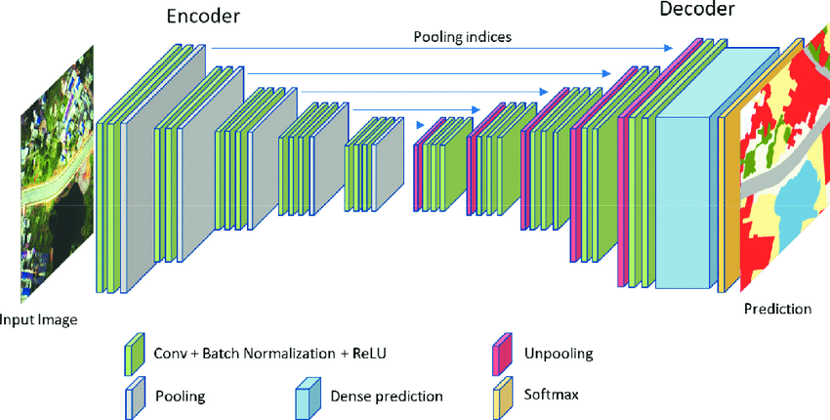
SEGNET MODEL
Model Structure

Slide 8
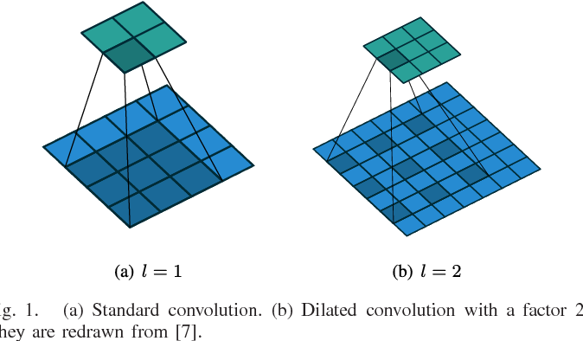
SEGNET MODEL
Encoder Structure
4 CONVOLUTION BLOCKS
First block consists of two normal convolution layers with max pooling and batch normalization
Second block is the same but with a 0.3 dropout to prevent overfitting
The last two blocks introduce dilated convolutions in the second convolutional layer

Slide 9
SEGNET MODEL
Decoder Structure
4 BLOCKS
The first step in the decoder is upsampling to reverse the downsampling done during encoding. This is followed by two convolutional layers and a Batch Normalization layer.
This is the final upsampling block, where the feature map is restored to the original input size, using 64 filters in the convolutional layers, similar to Block 1 in the encoder.

Slide 10
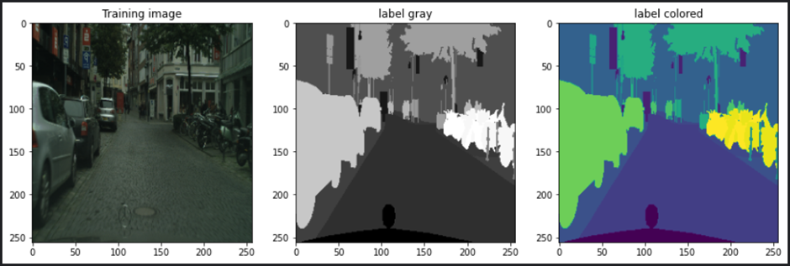
UNET MODEL
Input & Output
MODEL
(256, 256, 3)
(256, 256, ID)

Slide 11
UNET MODEL
What is UNet
U-Net is a convolutional neural network that was developed for image segmentation. The network is based on a fully convolutional neural network whose architecture was modified and extended to work with fewer training images and to yield more precise segmentation.
Why UNet
UNET is frequently utilized for its accuracy in picture segmentation and has become a popular choice in various imaging applications. UNET combines an encoding path, also called the contracting path, with a decoding path called the expanding path.

Slide 12
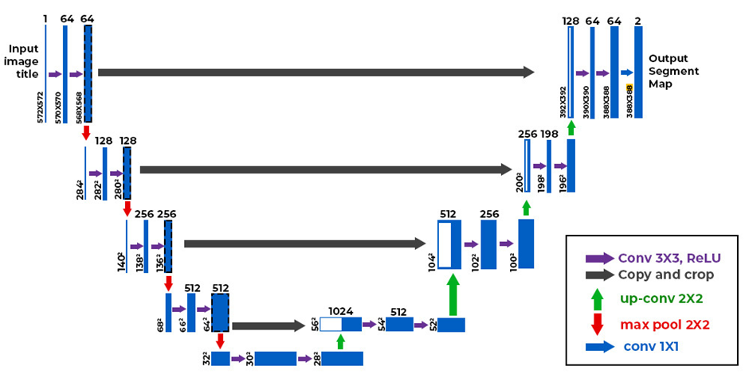
UNET MODEL
UNET STRUCTURE

Slide 13
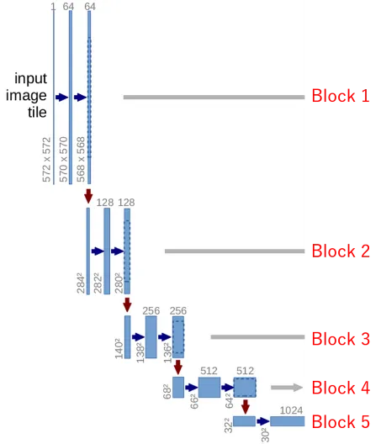
UNET MODEL
Contracting Path
Block 1:
Conv2D: 64 & Shape (None, 256, 256, 64) & MaxPooling
Block 2:
Conv2D: 128 & Shape (None, 128, 128, 128) & MaxPooling
Block 3:
Conv2D: 256 & Shape (None, 64, 64, 256) & MaxPooling
Block 4:
Conv2D: 512 & Shape (None, 32, 32, 512) & MaxPooling
Block 5:
Conv2D: 1024 & Shape (None, 16, 16, 1024) & MaxPooling
UNET STRUCTURE

Slide 14
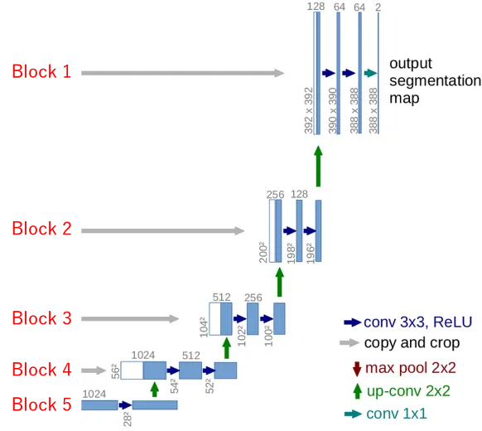
UNET MODEL
Expanding Path
Block 5:
Conv2D: 1024 & Shape (None, 16, 16, 1024) & Conv2DTranspose: 512
Block 4:
Conv2D: 512 & Shape (None, 32, 32, 512) & Conv2DTranspose: 256
Block 3:
Conv2D: 256 & Shape (None, 64, 64, 256) & Conv2DTranspose: 128
Block 2:
Conv2D: 128 & Shape (None, 128, 128, 128) & Conv2DTranspose: 64
Block 1:
Conv2D: 64 & Shape (None, 256, 256, 64)
UNET STRUCTURE

Slide 15
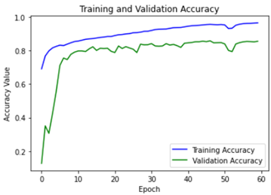
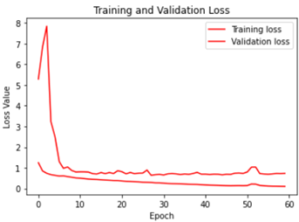
UNET MODEL
Training & Validation
Accuracy: 86%
Loss: 0.1060

Slide 16
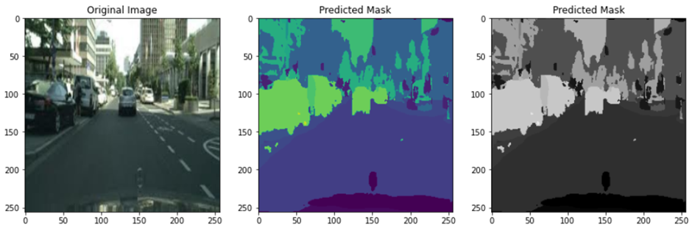
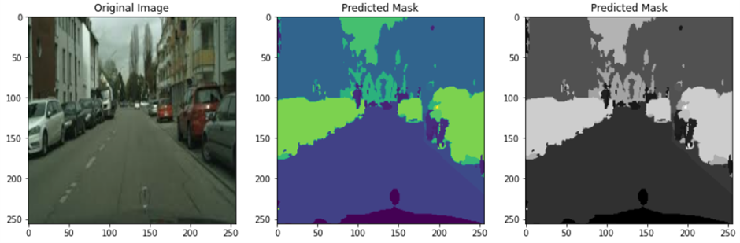
UNET MODEL
Predections

Slide 17
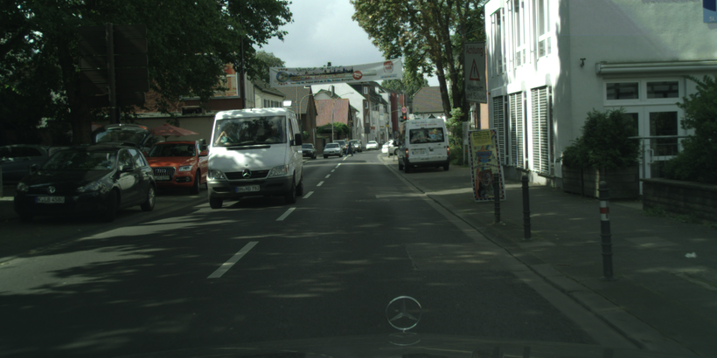
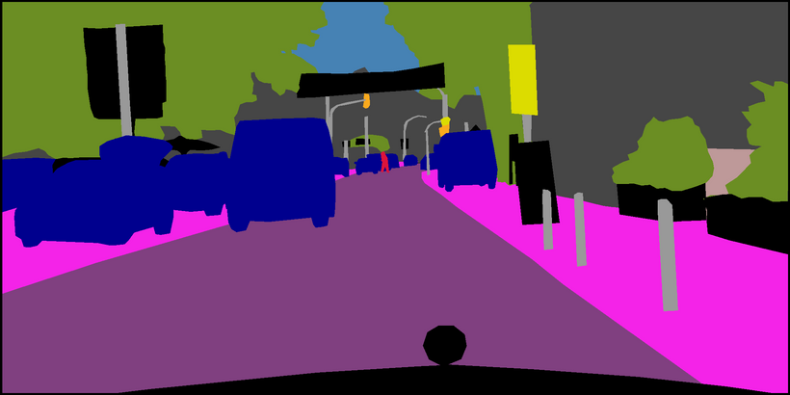
UNET + CSPNET MODEL
Data WorkFlow
MODEL
128 * 256 Softmax Pixels
(128, 256, 3)
(128, 256, 29)
ArgMax
29
Class to Color Mapping
Input
Output

Slide 18
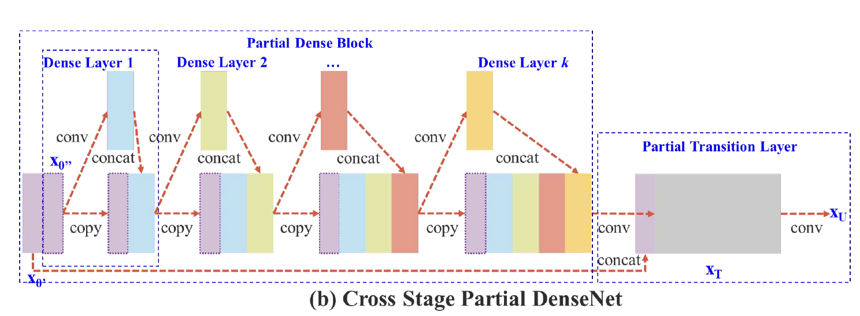
UNET + CSPNET MODEL
What is CSPNet
A neural network architecture that improves efficiency by splitting feature maps, partially processing them, and merging them to reduce duplicate gradient information. It enhances accuracy and reduces computation, commonly used in object detection and image classification.

Slide 19
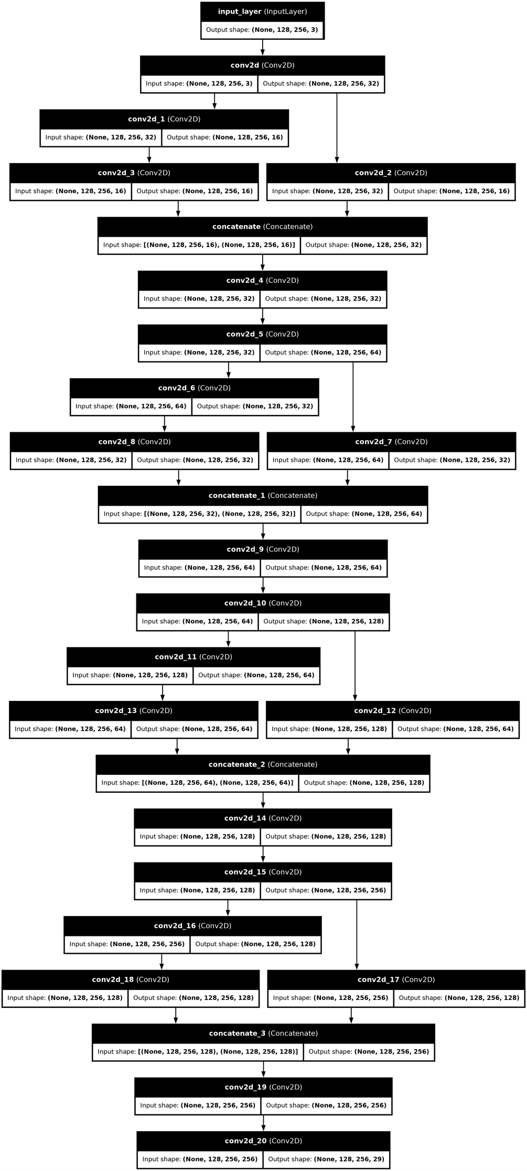
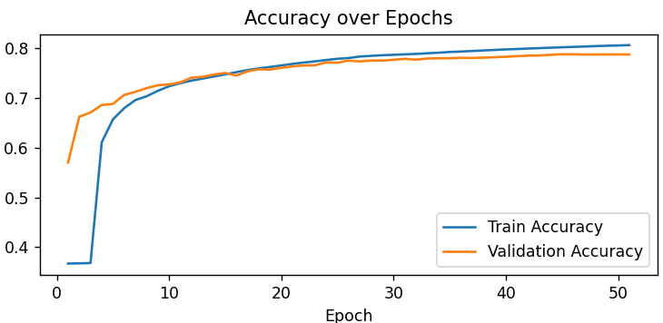
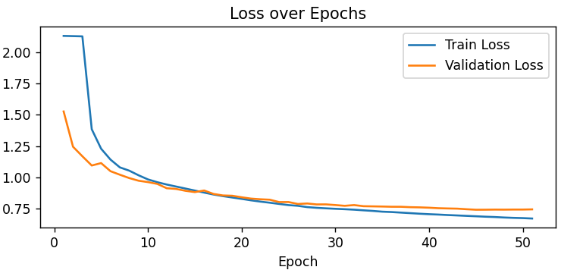
UNET + CSPNET MODEL
Pure CSPNet?
Pure CSPNet demonstrated better generalization compared to UNet, as it was less prone to overfitting. However, its training process was slower, and it seemed to have a performance cap, achieving lower maximum accuracy than what UNet could reach. Despite its improved generalization, CSPNet's slower convergence and limited peak performance made it less efficient overall.
Pure CSPNet

Slide 20
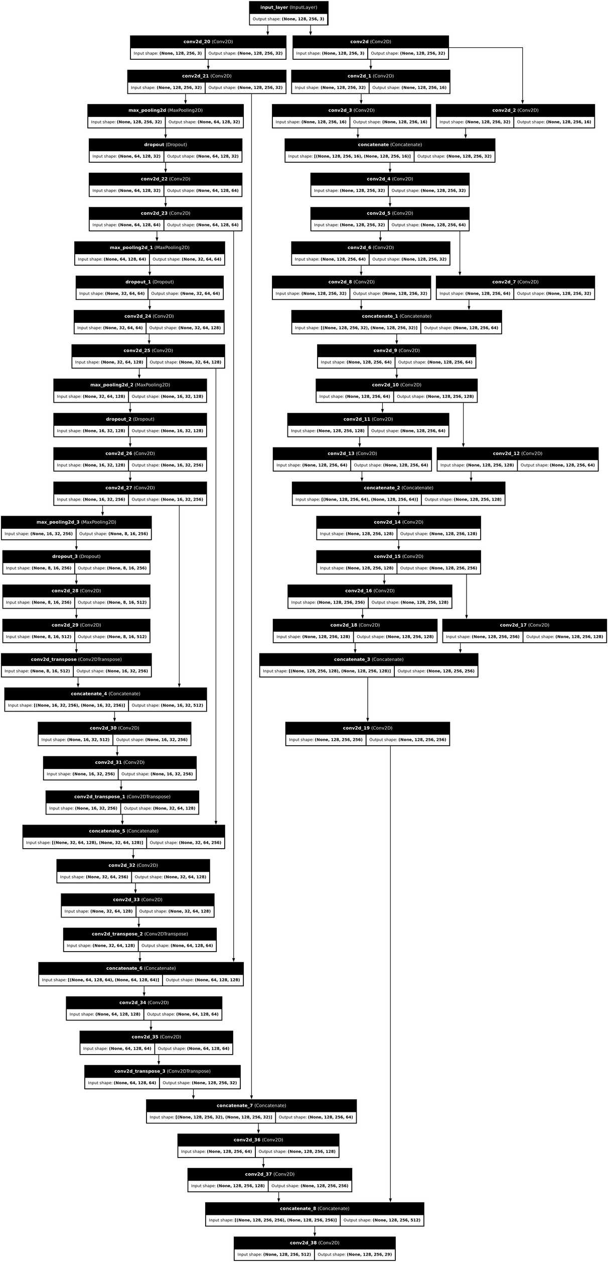
UNET + CSPNET MODEL
Input
UNet
CSPNet
Merge
SoftMax
Output
UNet + CSPNet in Parallel

Slide 21
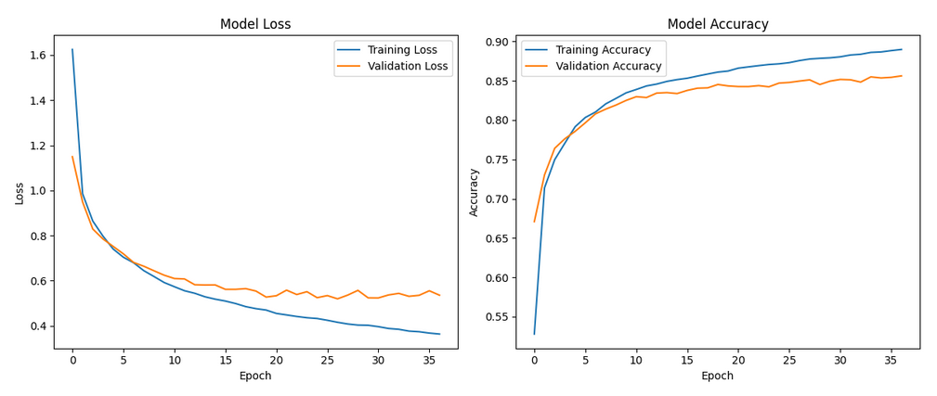
UNET + CSPNET MODEL
UNet + CSPNet
When using UNet and CSPNet in parallel, the model achieved better accuracy by leveraging the strengths of both architectures. UNet contributed faster learning, while CSPNet provided improved generalization due to its robustness. This combination allowed the model to balance speed and generalization, resulting in enhanced overall performance.
Here are the performance metrics:
Training Accuracy: 88.25%
Training Loss: 0.3875
Validation Accuracy: 84.97%
Validation Loss: 0.5192

Slide 22
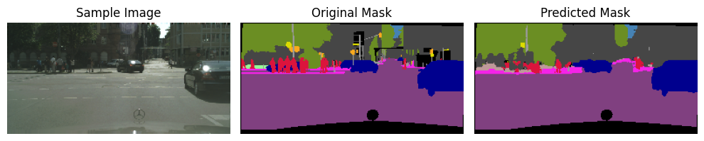
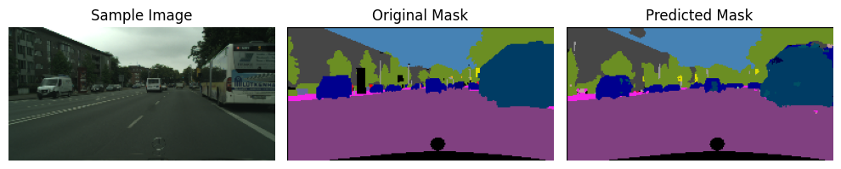
UNET + CSPNET MODEL
Results
Here are comparisons between the predicted and actual segmentations, showcasing the model's ability to retain details and its potential for further learning.

Slide 23
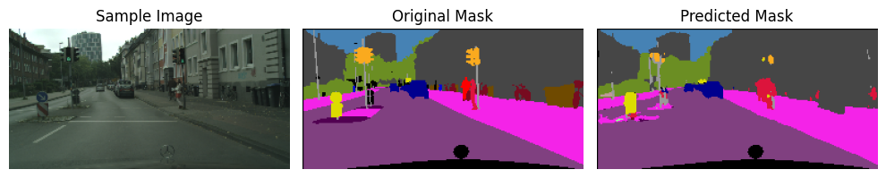
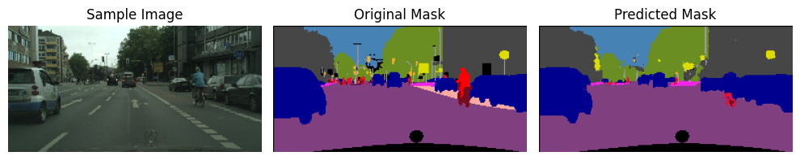
UNET + CSPNET MODEL
Results
Here are comparisons between the predicted and actual segmentations, showcasing the model's ability to retain details and its potential for further learning.

Slide 24




DATASET
CONTENT
CONTEXT
INSPIRATION
5 sets of 1,000 images with corresponding semantic segmentation labels.
Includes both RGB images and semantic segments
Dataset enables training machine learning models for identifying semantic segmentation of cars, roads, and other objects in images.
Aimed at contributing to the development of the **self-driving car** community

Slide 25
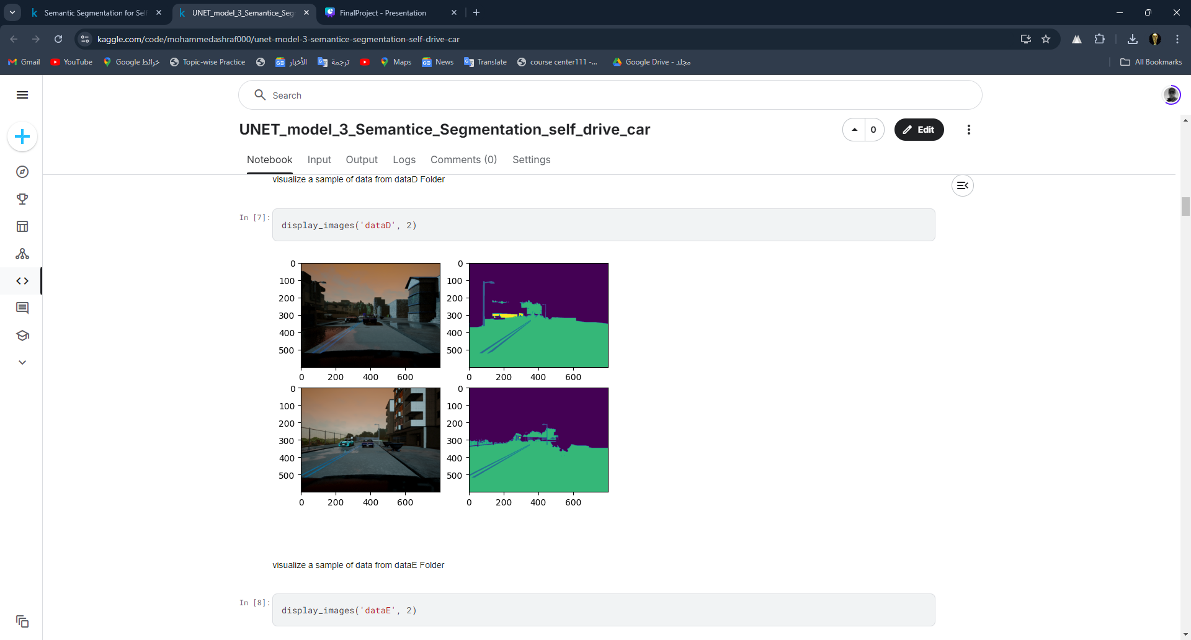
DATASET
REQUIRED INFORMATION
RGB Image Shape : (192, 256, 3)
Seg Image Shape : (192, 256, 1)
Number of labels : 13

Slide 26
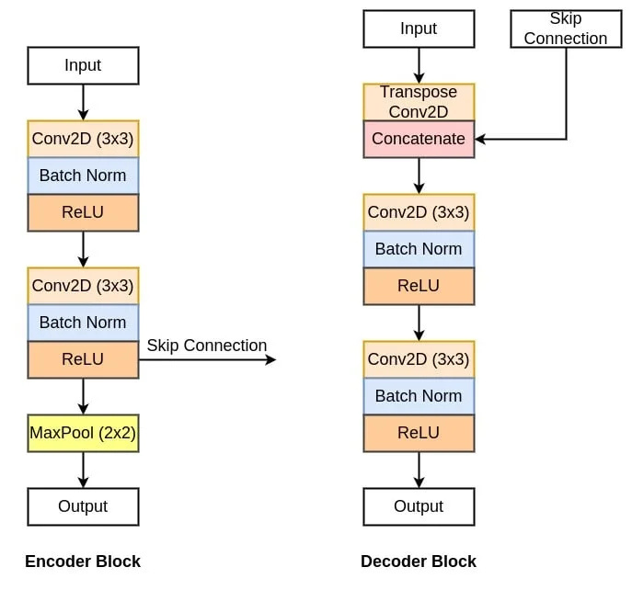
UNET
ARCHITECTURE
I built three architectures to see the difference between them and how the accuracy gets improved

Slide 27
UNET MODEL 1
ENCODER
DOWNSAMPLING BLOCK
Conv2D Layers: Two convolutional layers with 3x3 filters, ReLU activation, and he_normal initialization for feature extraction.
Dropout: Optional, used to prevent overfitting by randomly dropping neurons during training.
Max Pooling: Reduces spatial dimensions using a 2x2 pool size, decreasing computational load.
Skip Connection: Stores the output of the convolutional layers to be reused later, typically in U-Net or similar architectures.

Slide 28
UNET MODEL 1
DECODER
UPSAMPLING BLOCK
Conv2DTranspose: Used for upsampling to increase spatial dimensions.
Concatenation: Combines the upsampled feature map with the contractive input along the depth axis.
Convolutional layers: Two 3x3 convolutions with ReLU activation and He initialization for refining features after concatenation.
Purpose: This block is essential for reconstructing spatial information in architectures like U-Net.

Slide 29
UNET MODEL 1
CONNECTION
Input Layer: Takes images of size (96,128,3).
Contracting Path: Series of downsampling using conv_block_1 to extract features and reduce spatial dimensions.
Bottleneck Layer: Central part of the U-Net with the highest number of filters, no max pooling.
Expansive Path: Upsampling using upsampling_block to increase spatial dimensions and combine with features from the contracting path (skip connections).
Final Convolutional Layers: Two layers, the last with n_classes filters (13) and a 1x1 kernel for pixel-wise classification.
Output: The model predicts semantic segmentation with n_classes labels for each pixel.

Slide 30
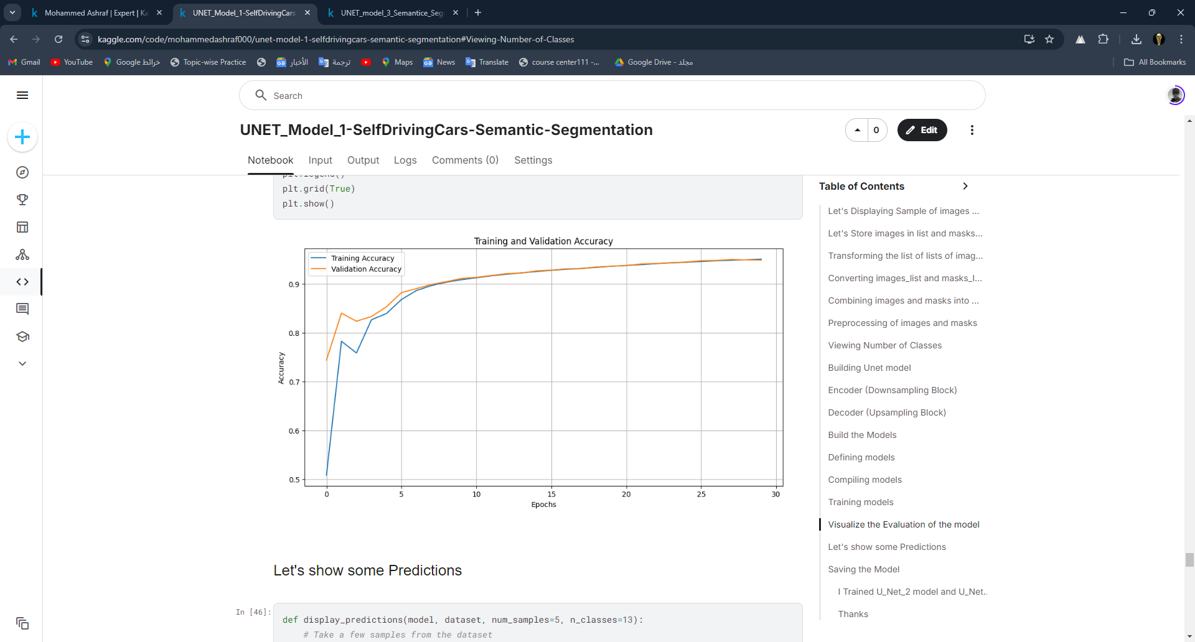
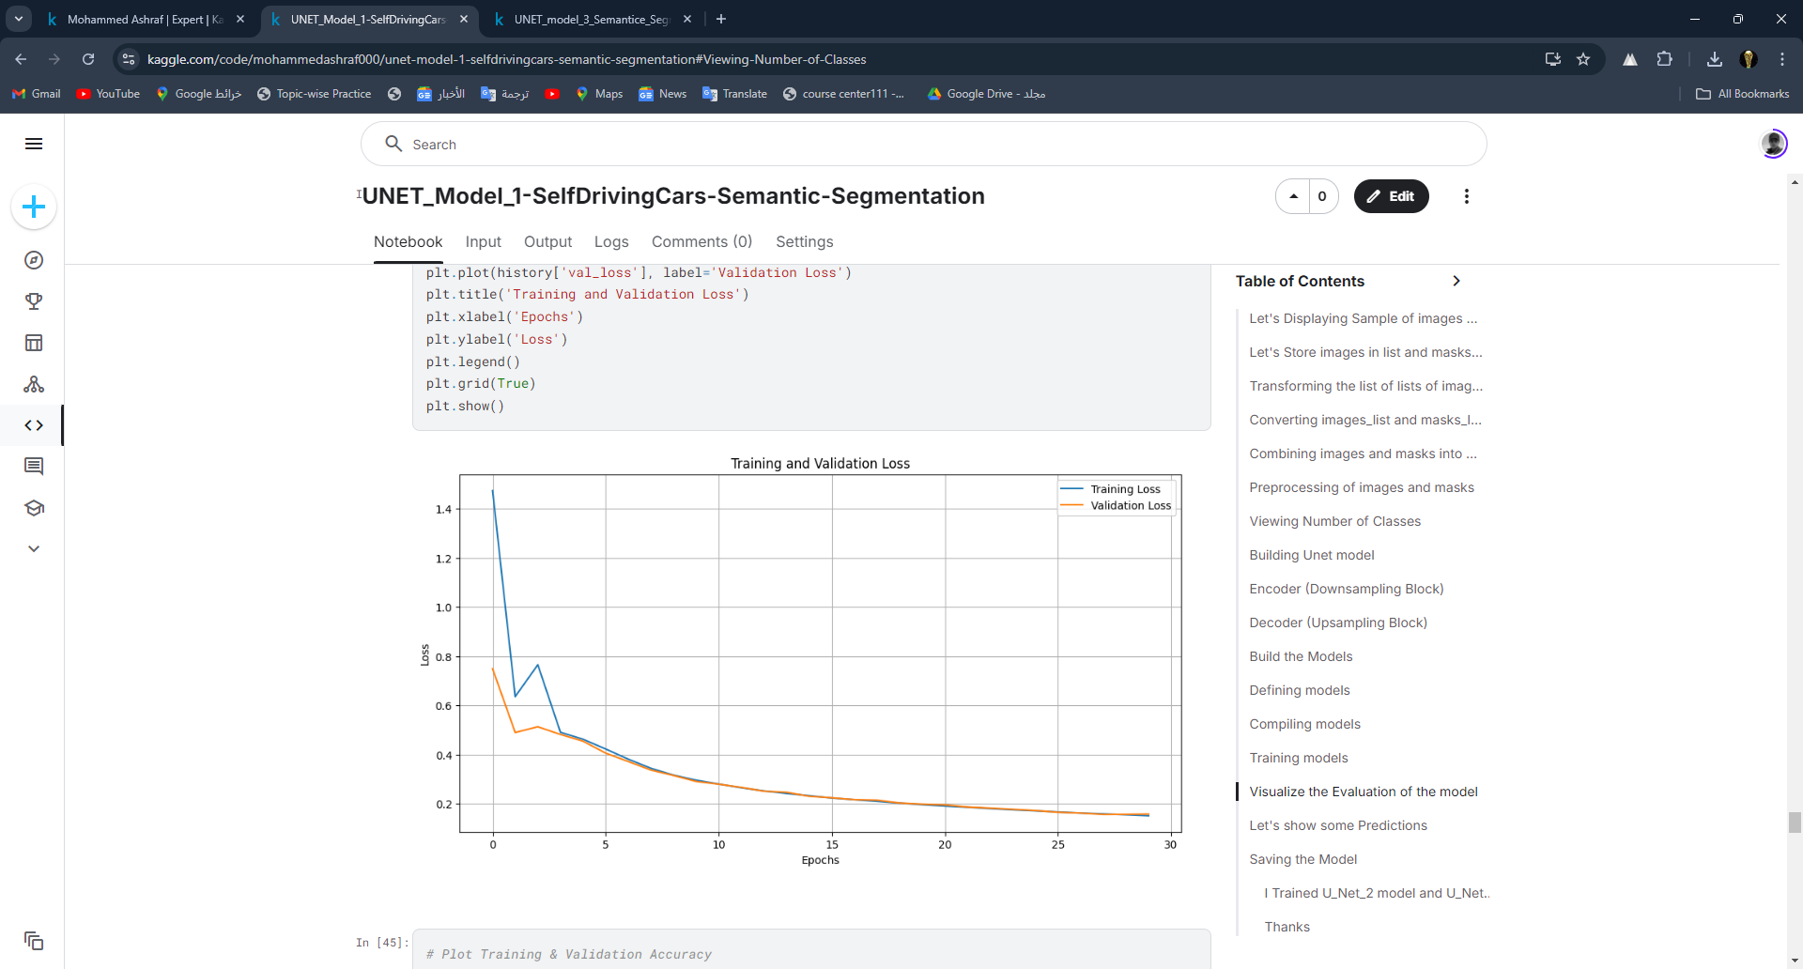
EVALUATION
TRAINING & VALIDATION ACCURACY
TRAINING & VALIDATION
LOSS

Slide 31
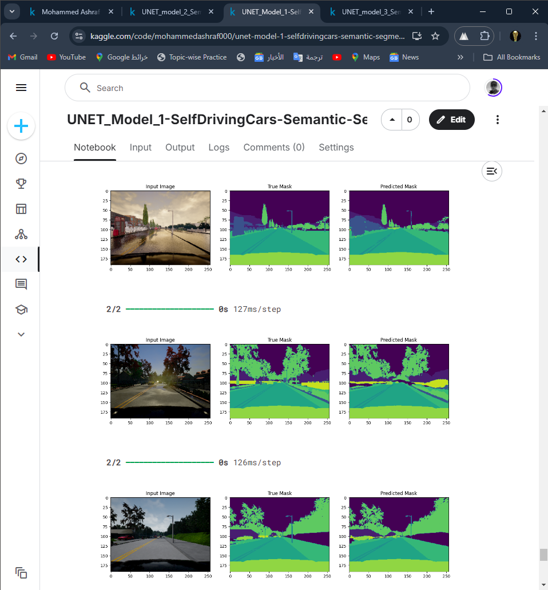
EVALUATION
TRAINING ACCURACY: 95.07%
LOSS: 0.1525
VALIDATION ACCURACY: 94.90%
VALIDATION LOSS: 0.1583

Slide 32
UNET MODEL 2
DIFFERENCES
The difference between the U-Net Model 1 and the U-Net Model 2 lies in the application of:
Batch Normalization: Added to improve training stability and performance.
ReLU Activation Function: Added to replace all negative values in the output with zero.

Slide 33
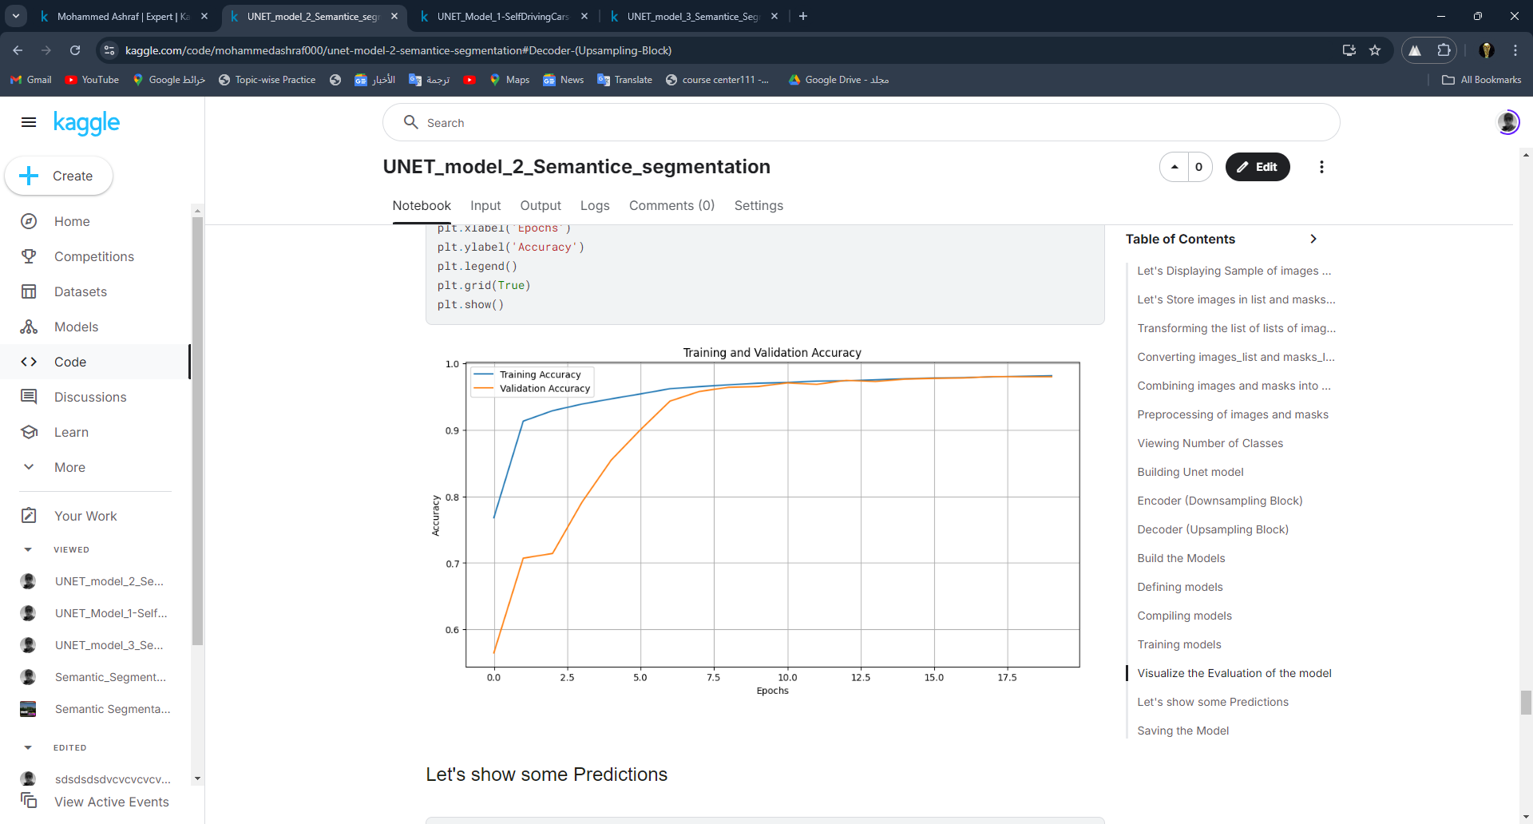
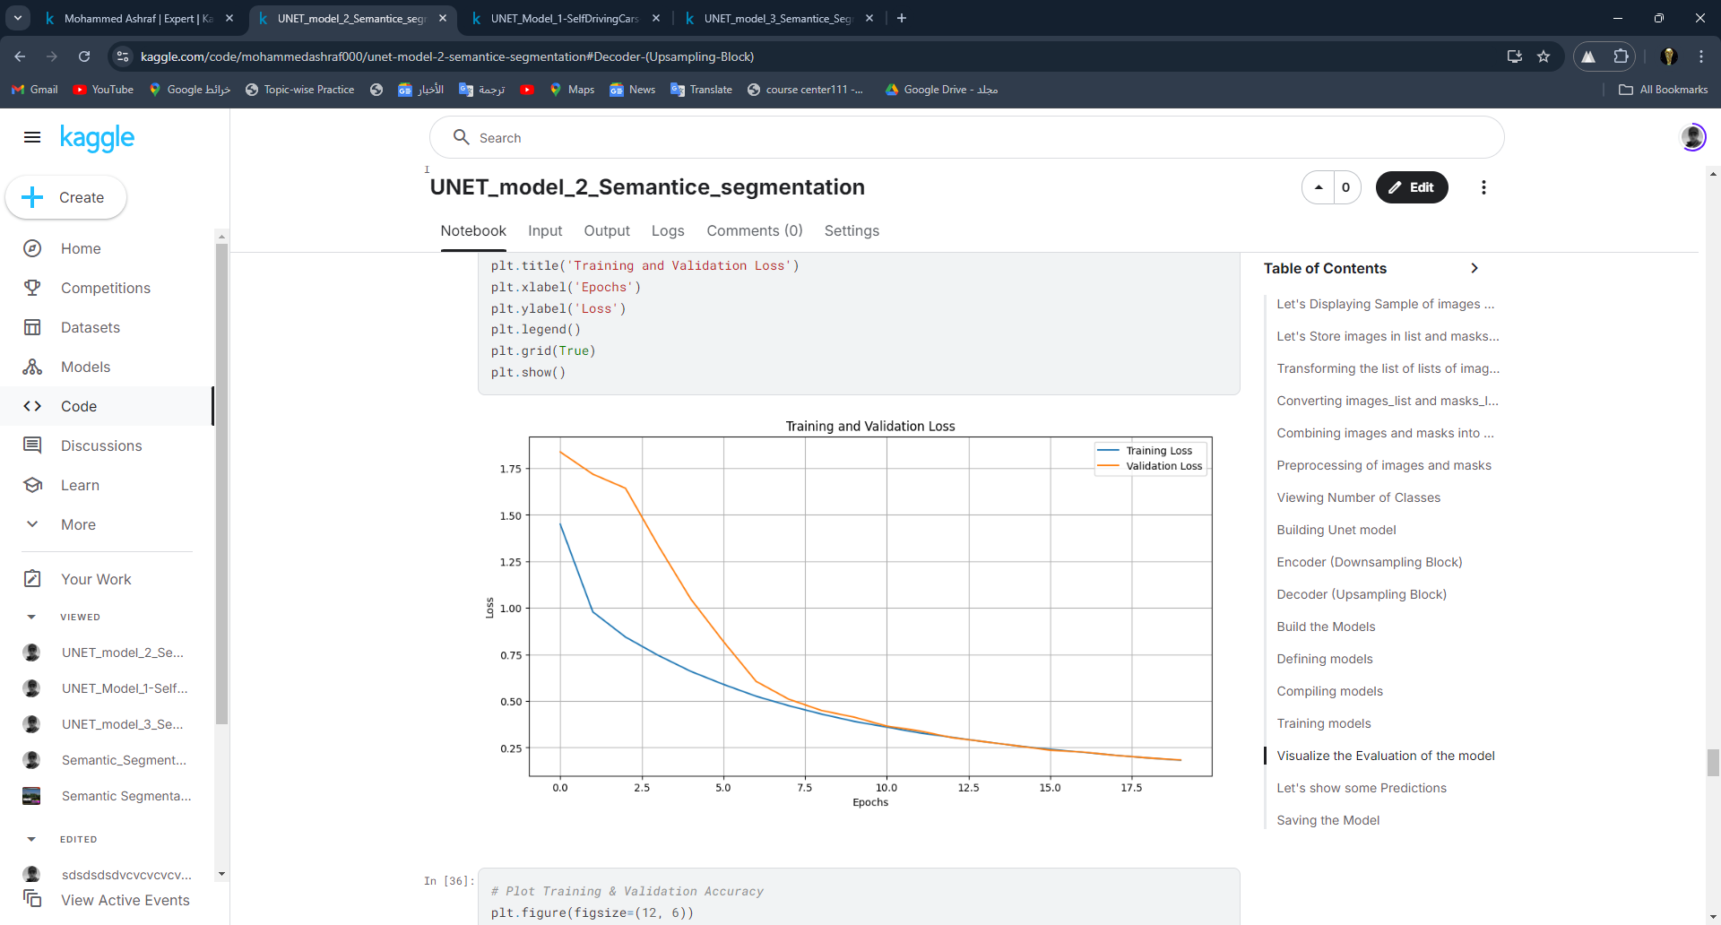
EVALUATION
TRAINING & VALIDATION ACCURACY
TRAINING & VALIDATION
LOSS

Slide 34
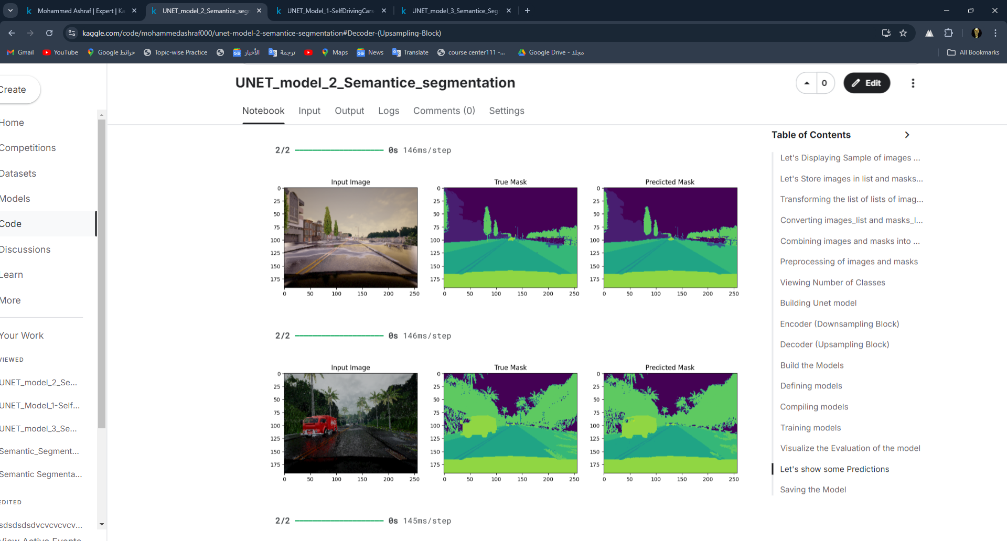
EVALUATION
TRAINING ACCURACY: 98.03%
TRAINING LOSS: 0.1985
VALIDATION ACCURACY: 97.98%
VALIDATION LOSS: 0.1838

Slide 35
UNET MODEL 3
DIFFERENCES
The difference between the U-Net Model 3 and the U-Net Model 2 lies in the application of:
Leaky ReLU: Allows a small, non-zero gradient when the input is negative, helping to mitigate the "dying ReLU" problem.

Slide 36
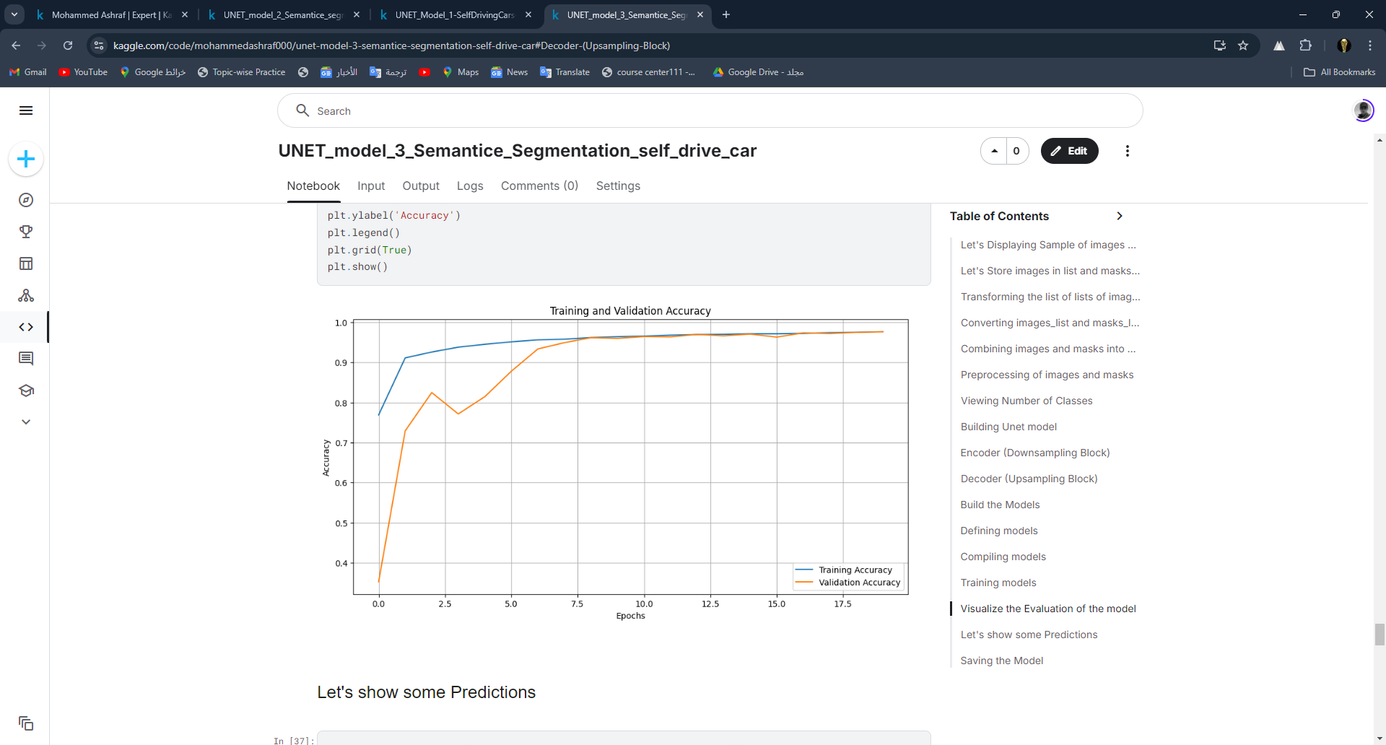
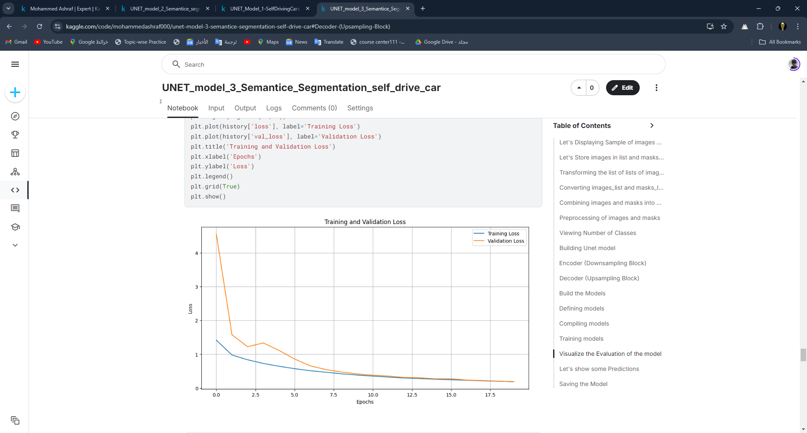
EVALUATION
TRAINING & VALIDATION ACCURACY
TRAINING & VALIDATION
LOSS

Slide 37
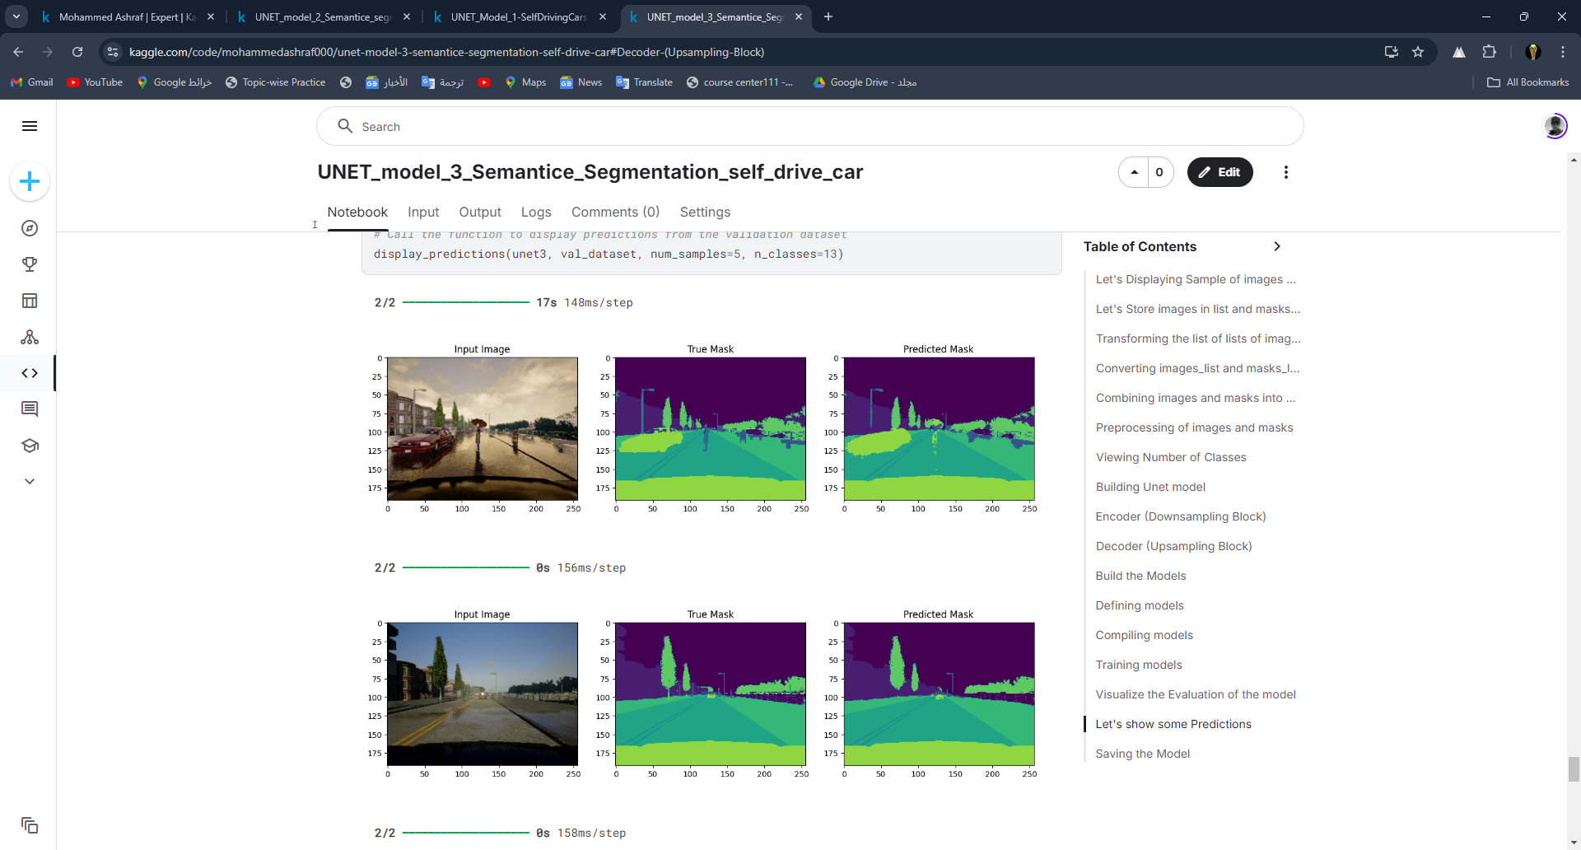
EVALUATION
TRAINING ACCURACY: 97.60%
TRAINING LOSS: 0.1878
VALIDATION ACCURACY: 97.61%
VALIDATION LOSS: 0.1860

Slide 38
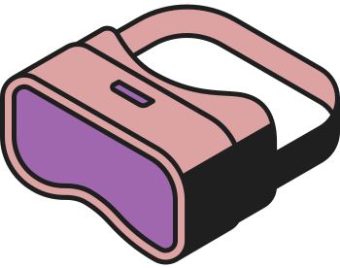



THANK YOU
COME AGAIN

